Slide 1
React Js
BUILD LARGE APPLICATIONS WITH DATA THAT CHANGES AGAIN AND AGAIN OVER TIME

Slide 2
Introduction
React is a JavaScript library used to build the user interface for web applications. React was initially developed and maintained by the folks at Facebook, which was later used in their products (WhatsApp & Instagram). Now it is an open source project with an active developer community. Popular websites like Netflix, Airbnb, Yahoo!Mail, KhanAcademy, Dropbox and many more use React to build their UI.
Modern websites are built using MVC (model view controller) architecture. React is the ‘V’ in the MVC which stands for view, whereas thearchitecture is provided by Redux or Flux. React native is used to develop mobile apps, the Facebook mobile app is built using React native.

Slide 3
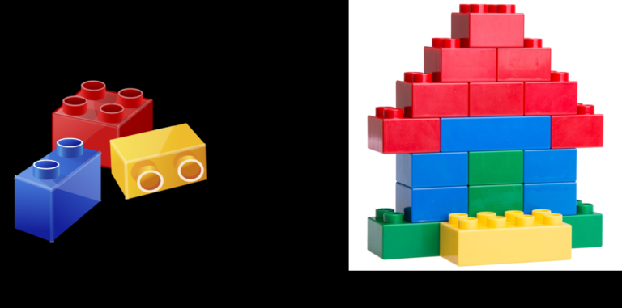
Component Based Structure
In ReactJS, everything is a component. Consider one lego house as an entire application. Then compare each of the lego block to a component which acts as a building block. These blocks/ components are integrated together to build one bigger and dynamic application.
The biggest advantage of using components is that, you can change any component at any point of time without affecting the rest of the applications. This feature is most effective when implemented with larger and real time applications where data changes frequently.
Each time any data is added or updated, ReactJS automatically updates the specific component whose state has actually changed. This saves the browser from the task of reloading the whole application to reflect the changes.

Slide 4
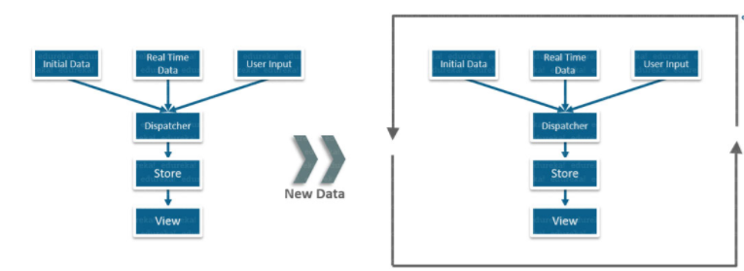
Why React?
The data is received from various sources like initial data, real time data and user input data which is passed to the dispatcher.
The dispatcher then forwards this data to the store, from where it ultimately comes to the view.

Slide 5
Why React?
Each time new data is added or any data is updated at the back end, the browser reloads the web page and repeats the whole process again.
This traditional data flow has one major drawback, it uses the DOM. DOM is an object that is created by the browser each time a web page is loaded which can dynamically add or remove the data at the back end. But each time any modifications were done a new DOM is created for the same page.
This repeated creation of DOM results in unnecessary memory wastage and decrease in applications performance.

Slide 6
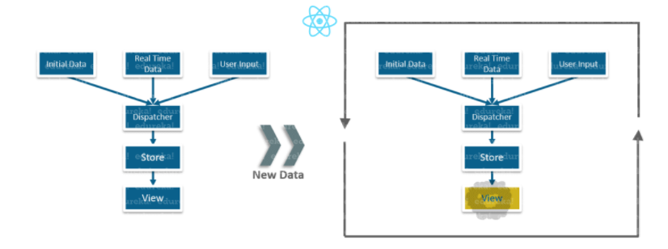
Why React?
With ReactJS, you can divide your entire application into various independent components. ReactJS applications still used the same traditional data flow, but something changed at the back end.
Instead of reloading the entire page, React just destroys the old view. Afterwards, it renders the view components with updates or new data and then places the new view in place of the old one.

Slide 7
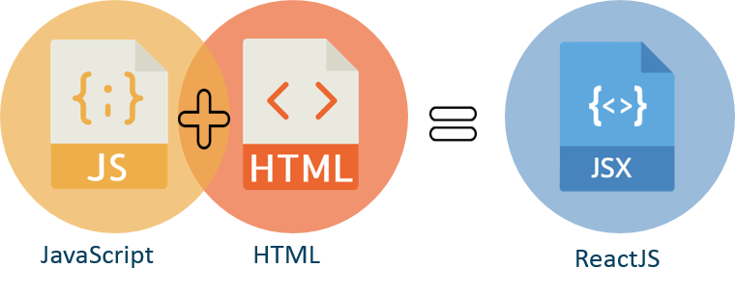
FEATURES OF REACT
1. JSX:
JSX stands for JavaScript XML. Its an XML/ HTML like syntax used by React. It extends the ECMAScript so that XML/ HTML like text can co-exist along with JavaScript react code.
With JSX, we can go a step further by again embedding the HTML code inside the JavaScript. This makes HTML codes easy to understand and boosts JavaScript’s performance while making our application robust.
var MyComponent = React.createClass({
render :function () {
return(
<h2>Hello World</h2>
);
}
});
ReactDOM.render(
<MyComponent/>, document.getElementById('content')
);

Slide 8
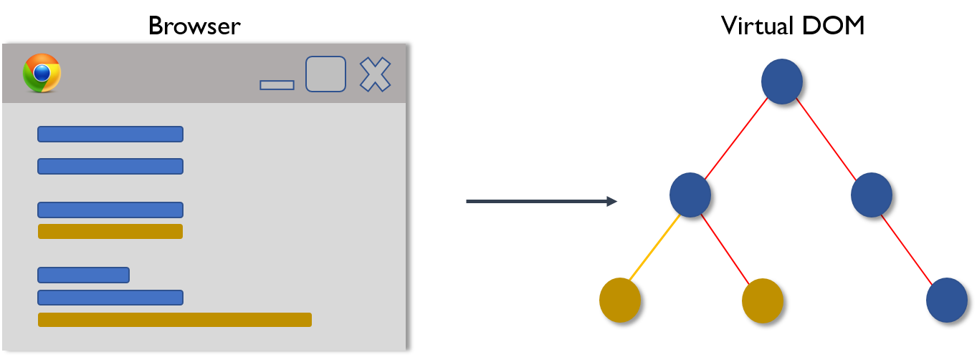
Features of React
2. Virtual DOM:
The Virtual DOM works in three simple steps
Whenever any underlying data changes, the entire UI is re-rendered in Virtual DOM representation.

Slide 9
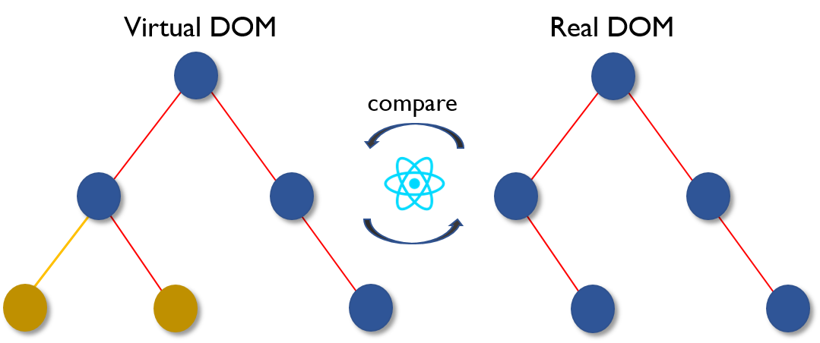
Features of React
Then the difference between the previous DOM representation and the new one is calculated.

Slide 10
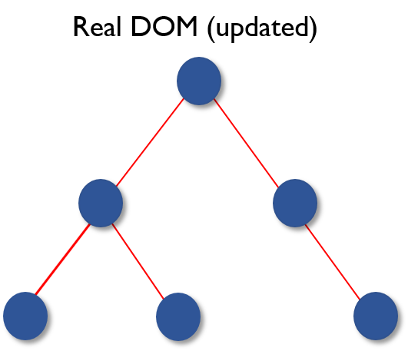
Features of React
Once the calculations are done, the real DOM will be updated with only the things that have actually changed. You can think of it as a patch. As patches are applied only to the affected area, similarly, the virtual DOM acts as patches and are applied to the elements which are updated or changed, in the real DOM.
This makes our application faster and there is no memory wastage.

Slide 11
Features of React
One-Way Data Binding:
Unlike other frameworks, ReactJS follows unidirectional data flow or one way data binding. Major advantage of One-Way-Data binding is that, throughout the application the data flows in a single direction which gives you better control over it.
Because of this, application’s state is contained in specific stores and as a result, rest of the components remains loosely coupled. This makes our application more flexible leading to increased efficiency.

Slide 12
References
https://www.edureka.co/blog/reactjs-tutorial
https://medium.com/@thinkwik/why-reactjs-is-gaining-so-much-popularity-these-days-c3aa686ec0b3

Slide 13


